Slide 1
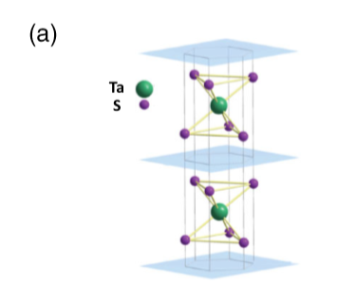

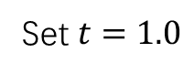
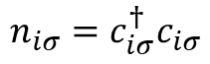
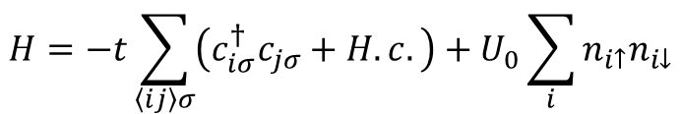
$$H=−t\sum_{\left\langle ij\right\rangle σ}{\left(c_{iσ}^{†}c_{jσ}+H.c.\right)}+U_{0}\sum_{i}{n_{i↑}n_{i↓}}$$
$$n_{iσ}=c_{iσ}^{†}c_{iσ}$$
Set $t=1.0$

Slide 2
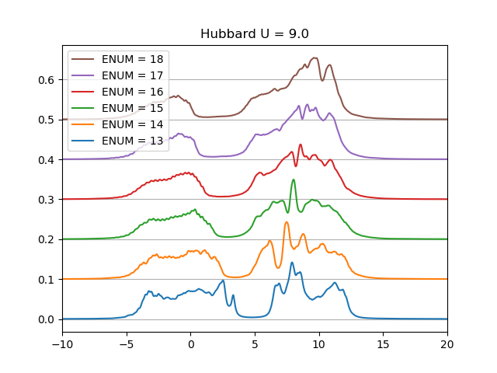
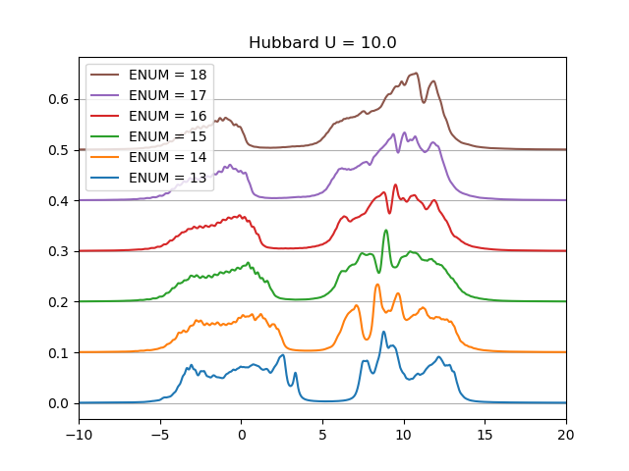
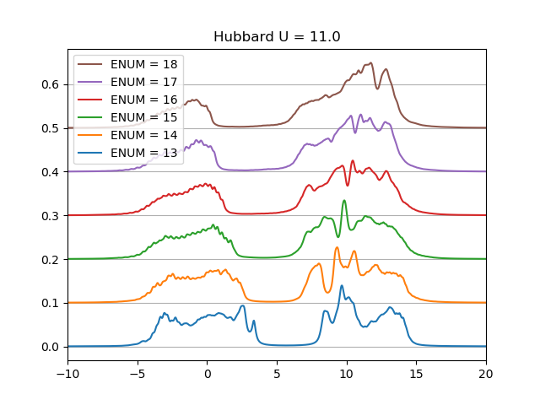
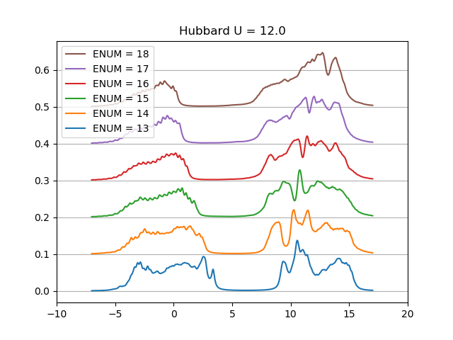
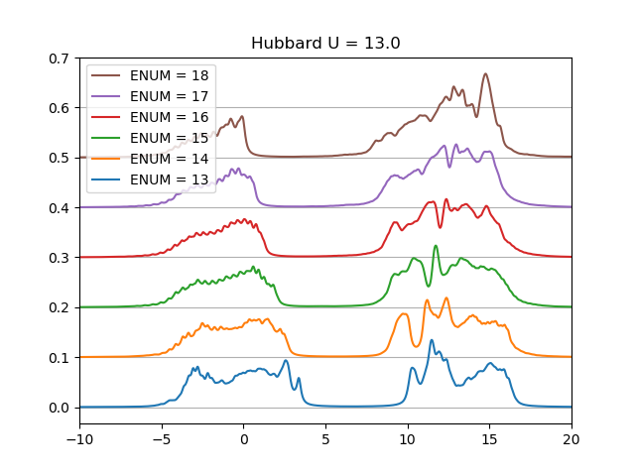

Slide 3
STS Spectra with K Doping

Slide 4
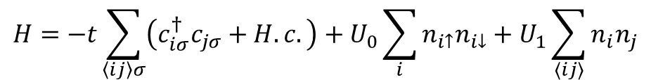
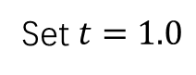
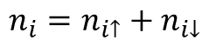
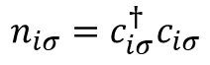
$$H=−t\sum_{\left\langle ij\right\rangle σ}{\left(c_{iσ}^{†}c_{jσ}+H.c.\right)}+U_{0}\sum_{i}{n_{i↑}n_{i↓}}+U_{1}\sum_{⟨ij⟩}{n_{i}n_{j}}$$
$$n_{iσ}=c_{iσ}^{†}c_{iσ}$$
$$n_{i}=n_{i↑}+n_{i↓}$$
Set $t=1.0$
$$H_{mean}=−t\sum_{\left\langle ij\right\rangle σ}{\left(c_{iσ}^{†}c_{jσ}+H.c.\right)}+U_{0}\sum_{i}{\left({⟨n}_{i↓}⟩n_{i↑}+{⟨n}_{i↑}⟩n_{i↓}\right)}+U_{1}\sum_{\left\langle ij\right\rangle }{\left(\left\langle n_{i}\right\rangle n_{j}+\left\langle n_{j}\right\rangle n_{i}\right)}+const$$

Slide 5
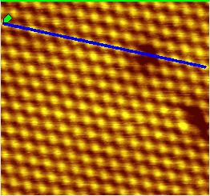

STS Line Map Taken at the Clean Surface
STS line map
1V, 200pA, modulation: 15mV

Slide 6
K: 17s
+ Pulse
K: 17s
K: 1s

Slide 7
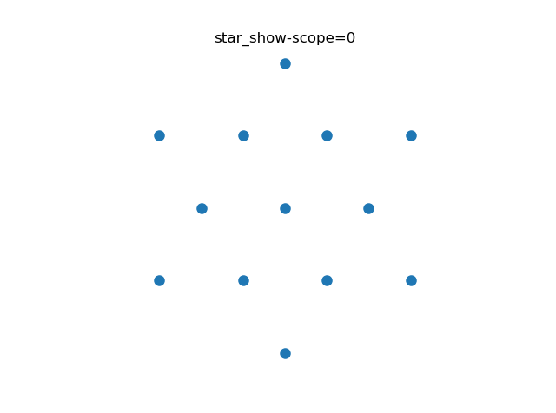
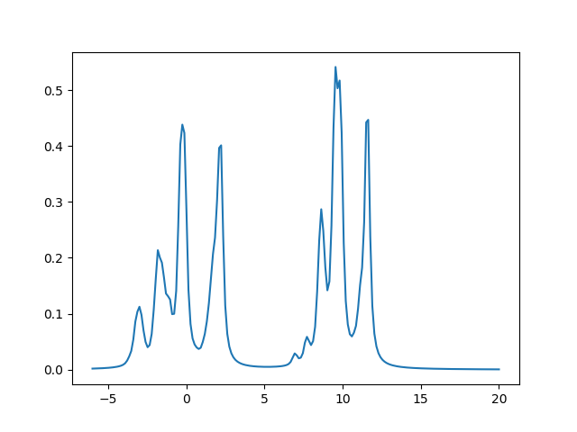
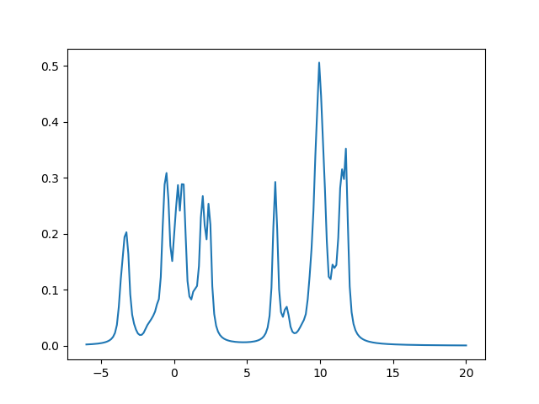
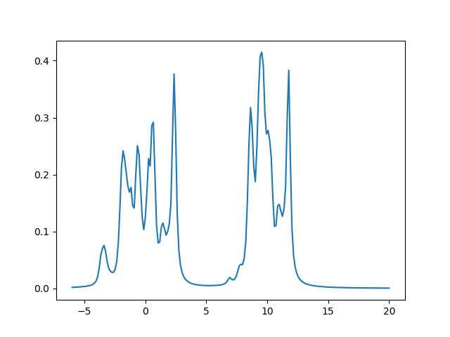
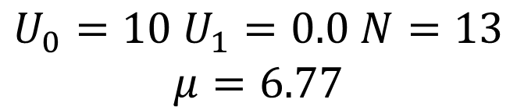
$$U_{0}=10 U_{1}=0.0 N=13$$
$$μ=6.77$$

Slide 8
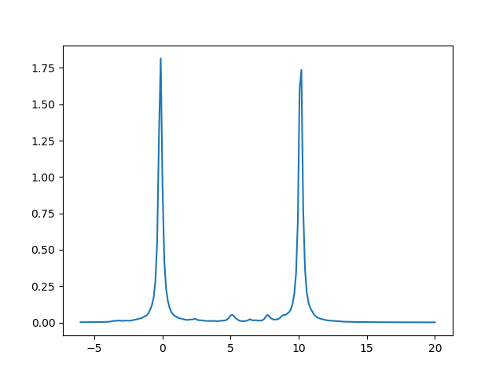
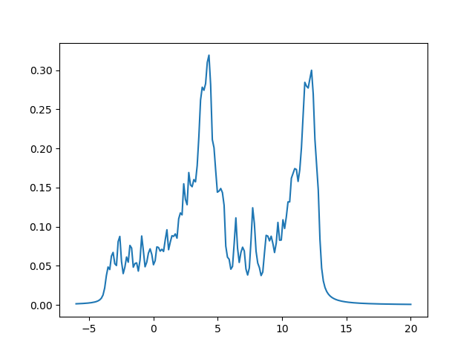

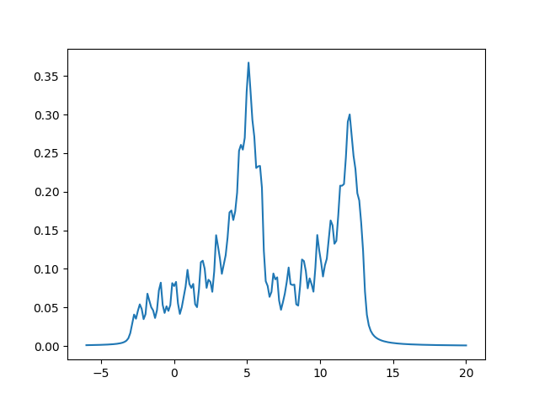

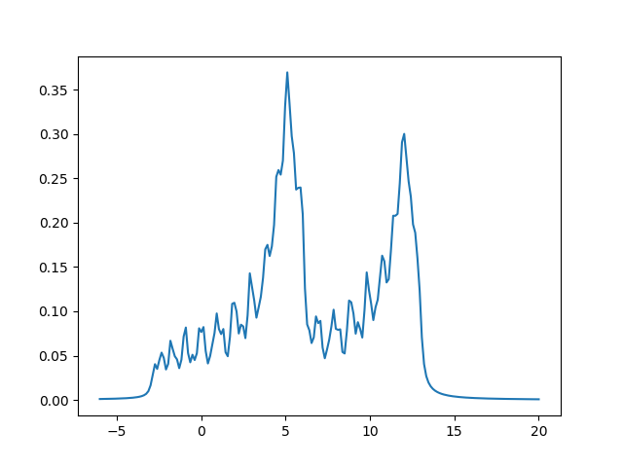
$$U_{0}=10 U_{1}=0.0 N=15 μ=7.7$$
$$U_{0}=10 U_{1}=0.0 N=17 μ=8.96$$

Slide 9
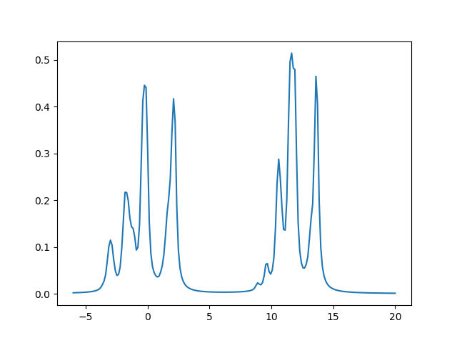
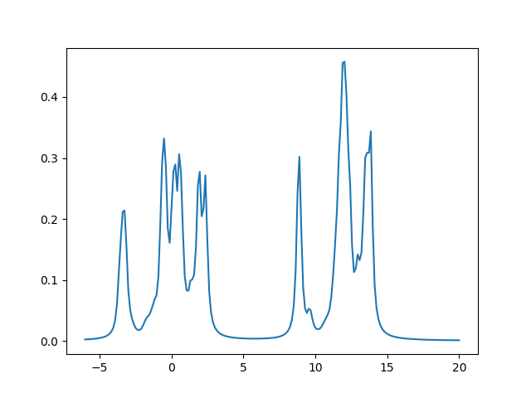
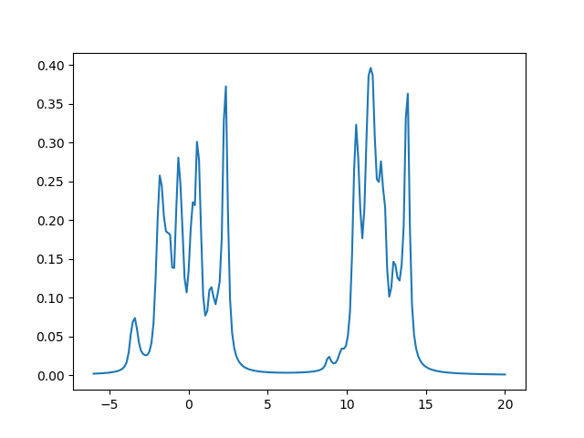
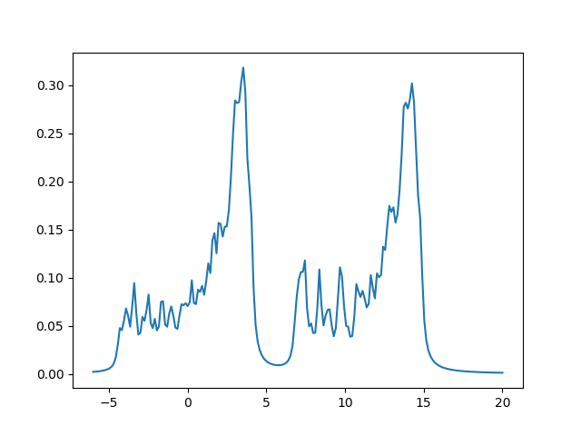
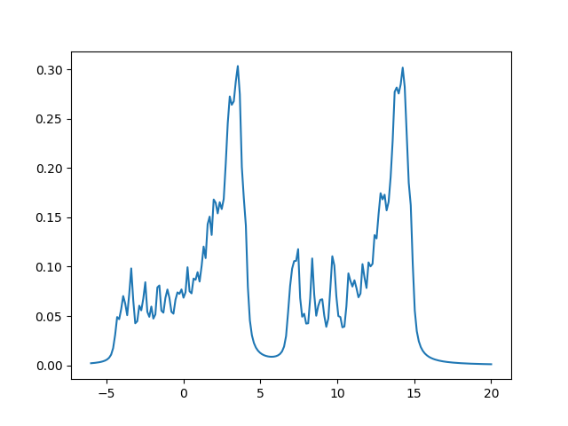
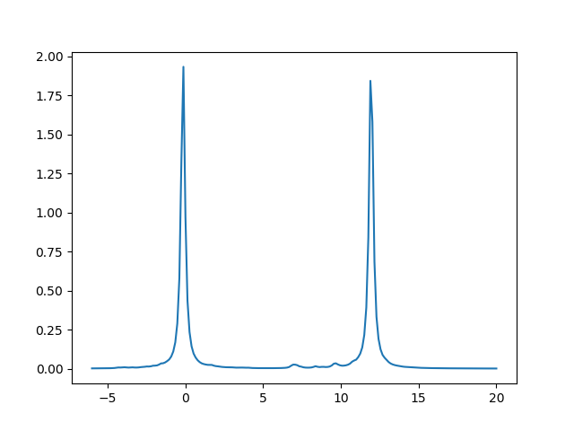
$$U_{0}=12 U_{1}=2 N=13 μ=8.75$$
$$U_{0}=12 U_{1}=2 N=14 μ=7.85$$

